Slide 1
Principles for Moving Forward, Lessons from Looking Back
J. Benjamin Hurlbut School of Life Sciences Arizona State University
Notes:
Historian of science– study institutions of governance.
These are not complicated ideas in the concrete.

Slide 2
Project overview
Which way is forward (and how do we decide)?
Notes:
About the moral fabric of a society– not merely in terms of how we ask questions like “is it a person”, but how we make our deliberative institutions, and who we trust to know best—
-- not unlike H5N1 case– complex, scientifically uncertain area, prediction about the future that may or may not come to pass, reliance on experts to get the job done, but with uncertain consequences for others (moral, social, cultural, biological); the question of who is responsible for asking and answering these questions– scientists?, governments? Individuals? (which individuals)?

Slide 3
Project overview
“the unthinkable has become conceivable…
…Now we must face the questions that arise: how, if at all, do we as a society want to use this capability?”
Notes:
About the moral fabric of a society– not merely in terms of how we ask questions like “is it a person”, but how we make our deliberative institutions, and who we trust to know best—
-- not unlike H5N1 case– complex, scientifically uncertain area, prediction about the future that may or may not come to pass, reliance on experts to get the job done, but with uncertain consequences for others (moral, social, cultural, biological); the question of who is responsible for asking and answering these questions– scientists?, governments? Individuals? (which individuals)?

Slide 4
Project overview
“the unthinkable has become actual…
…Now we must face the questions that arise: how, if at all, do we as a society want to use this capability?”
Notes:
About the moral fabric of a society– not merely in terms of how we ask questions like “is it a person”, but how we make our deliberative institutions, and who we trust to know best—
-- not unlike H5N1 case– complex, scientifically uncertain area, prediction about the future that may or may not come to pass, reliance on experts to get the job done, but with uncertain consequences for others (moral, social, cultural, biological); the question of who is responsible for asking and answering these questions– scientists?, governments? Individuals? (which individuals)?

Slide 5
Project overview
How did we get here?
(And how can we do better?)
Notes:
About the moral fabric of a society– not merely in terms of how we ask questions like “is it a person”, but how we make our deliberative institutions, and who we trust to know best—
-- not unlike H5N1 case– complex, scientifically uncertain area, prediction about the future that may or may not come to pass, reliance on experts to get the job done, but with uncertain consequences for others (moral, social, cultural, biological); the question of who is responsible for asking and answering these questions– scientists?, governments? Individuals? (which individuals)?

Slide 6
The ways we think and speak about scientific and technological change shapes the ways we guide and govern it.
Notes:
We are swept along with these changes only if we choose to go with the flow. Rudderless.

Slide 7
Project overview
Self fulfilling prophecy
“germline editing is going to happen, and to think otherwise is naïve…”
Notes:
About the moral fabric of a society– not merely in terms of how we ask questions like “is it a person”, but how we make our deliberative institutions, and who we trust to know best—
-- not unlike H5N1 case– complex, scientifically uncertain area, prediction about the future that may or may not come to pass, reliance on experts to get the job done, but with uncertain consequences for others (moral, social, cultural, biological); the question of who is responsible for asking and answering these questions– scientists?, governments? Individuals? (which individuals)?

Slide 8
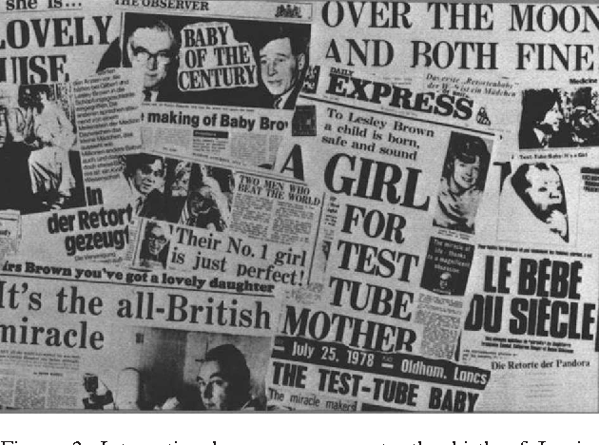
IVF/Louise
Notes:
In july of 1978, Louis brown, the first “test-tube” baby was born. As it happened, the United states already had a public bioethics body discussing in vitro fertilization— the ethics advisory board. This ethics body is little remembered, but it left an important mark on these debates.
The board was both diverse in its membership and pragmatic. It worked hard to keep its is deliberations grounded and pragmatic. It did this by keeping focusing on IVF as a technology, and not on the more vexing problem of the moral standing of human embryos. It did this by leaning on some specific facts.
First was that louis brown was conceived using a single egg— no superovulation. Second was a set of recent studies suggesting a high rate of “embryo loss” in normal human reproduction. These facts did two things for the board. First, they helped it to see embryo loss in IVF as a feature of nature rather than an artifact of the laboratory, thus shifting responsibility from scientist to nature. Second, it allowed board members to argue that IVF was analogous to in vivo fertilization; it was essentially the same process, simply displaced to the laboratory. The more it could be naturalized, the less ethical questions they had to face, and the less problems of values-pluralism surfaced. On the basis of analogy to nature, the board concluded that so long as IVF was used to replicate— and not transcend— natural human reproduction, it was “ethically acceptable, but legitimately controverted.”
To be clear, this was not based on the notion that embryo loss means the embryo has lower moral status, but rather that the technology was nature-like, and, if kept nature-like, was in keeping with the goals of medicine to heal. Incidentally, the member of the board who most actively pushed for this line of reasoning was catholic moral philosopher Richard McCormick.
This did two things: 1) it allowed the board to describe treat IVF as a therapeutic rather than experimental research. And 2) as a therapy, belong to the private space of clinical medicine where doctors and patients decide together—for this they made a constitutional argument why it therefore could not be the government’s business, referring to roe, etc) .
-- boundary between public and private– made a space for individual moral decision making (very different than Germany, UK, most other countries.)

Slide 9
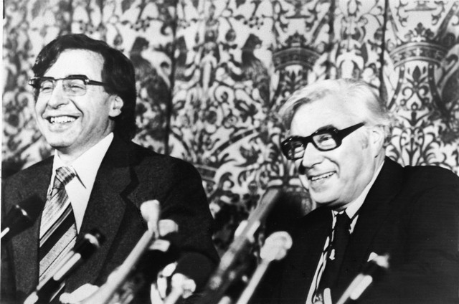
carr
Robert Edwards and Patrick Steptoe (1978)
Notes:
But, as the bill was debated in April,1981, an embryo had just completed implantation in the uterine wall. Two weeks earlier the embryo had been fertilized in vitro at a clinic in Norfork, Virginia. 35 weeks later this embryo was born as Elizabeth Carr, the first American ‘test-tube baby’– here she is at her first birthday.
By the mid 1980s, in vitro fertilization (IVF) was growing increasingly common in the United States. By 1987, 5000 IVF babies had been born worldwide, 1000 of them in the US. There were 220 IVF clinics worldwide, conducting a total of 30,000 treatment cycles annually and producing roughly 150,000 embryos per year. About a third of them were in the United States. One year later, the US number had increased by 50 percent.

Slide 10
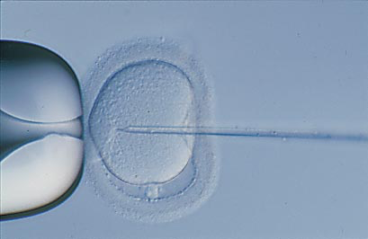
Varmus/wilmut
Intra Cytoplasmic Sperm Injection (1991)

Slide 11
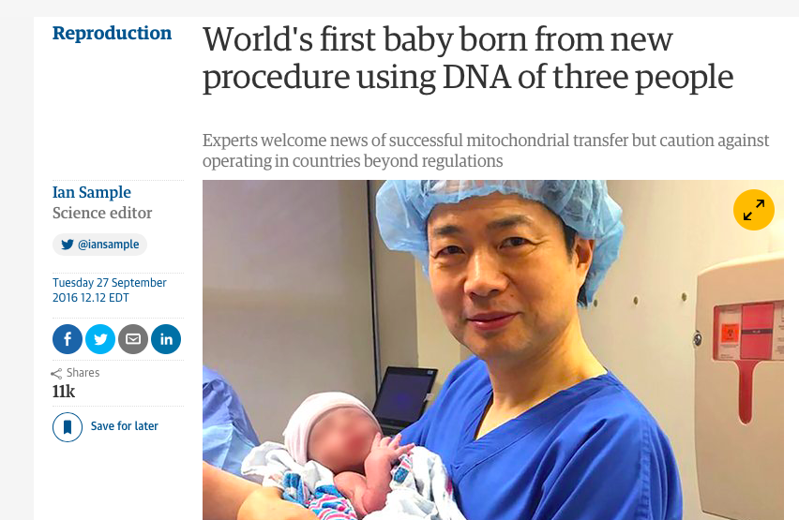
IVF/Louise
“…where there are no rules…[because] to save lives is the ethical thing to do.”

Slide 12
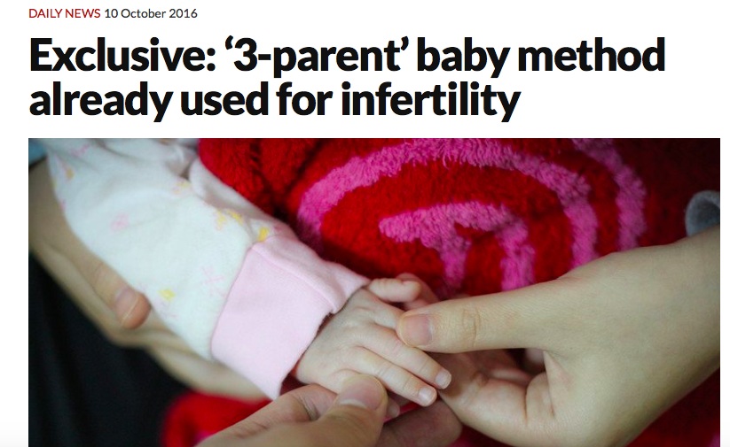
IVF/Louise

Slide 13
Project overview
Science races ahead,
society [law, ethics] lags behind
“….as is always the case, the speed at which the science is advancing outpaces societies ability to grasp its implications.”
Notes:
About the moral fabric of a society– not merely in terms of how we ask questions like “is it a person”, but how we make our deliberative institutions, and who we trust to know best—
-- not unlike H5N1 case– complex, scientifically uncertain area, prediction about the future that may or may not come to pass, reliance on experts to get the job done, but with uncertain consequences for others (moral, social, cultural, biological); the question of who is responsible for asking and answering these questions– scientists?, governments? Individuals? (which individuals)?

Slide 14
Project overview
“new era of fundamental danger triggered by the rapid growth of genetic engineering…[raises the question of] the fundamental nature of human life and the dignity and worth of the individual human being.”
(Letter to Carter Administration, General Secretaries of the National Council of Churches, the Synagogue Council of America, and the United States Catholic Conference, 1980)
Notes:
About the moral fabric of a society– not merely in terms of how we ask questions like “is it a person”, but how we make our deliberative institutions, and who we trust to know best—
-- not unlike H5N1 case– complex, scientifically uncertain area, prediction about the future that may or may not come to pass, reliance on experts to get the job done, but with uncertain consequences for others (moral, social, cultural, biological); the question of who is responsible for asking and answering these questions– scientists?, governments? Individuals? (which individuals)?

Slide 15
Incremental (Reactive) Bioethics
"I understand the concern about where we might go. I'm going to worry about that when I get there.”

Slide 16
Project overview
Obsolete Norms?
“There has been a line drawn by many that says…you should refrain. That was mostly because there was no way of considering how to do that at all....so nobody was arguing that it should be done.”
Notes:
About the moral fabric of a society– not merely in terms of how we ask questions like “is it a person”, but how we make our deliberative institutions, and who we trust to know best—
-- not unlike H5N1 case– complex, scientifically uncertain area, prediction about the future that may or may not come to pass, reliance on experts to get the job done, but with uncertain consequences for others (moral, social, cultural, biological); the question of who is responsible for asking and answering these questions– scientists?, governments? Individuals? (which individuals)?

Slide 17
Governance (of S&T) is a problem of democratic governance that depends upon collectively seeing, affirming and regularly revisiting how, why, and to whom we delegate authority and responsibility.
Notes:
We are swept along with these changes only if we choose to go with the flow. Rudderless.

Slide 18
Project overview
…how, if at all, do we as a society want to use this capability?”
Notes:
About the moral fabric of a society– not merely in terms of how we ask questions like “is it a person”, but how we make our deliberative institutions, and who we trust to know best—
-- not unlike H5N1 case– complex, scientifically uncertain area, prediction about the future that may or may not come to pass, reliance on experts to get the job done, but with uncertain consequences for others (moral, social, cultural, biological); the question of who is responsible for asking and answering these questions– scientists?, governments? Individuals? (which individuals)?

Slide 19
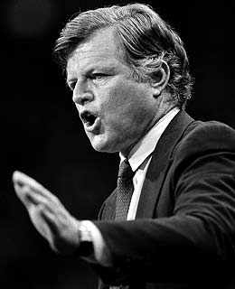
Sen. Ted Kennedy (D-MA)
“The factors under consideration [at Asilomar] extend far beyond [the scientists’] technical competence. In fact they were making public policy. And they were making it in private.”
Notes:
Walter mondale, ted kennedy

Slide 20
Project overview
“Broad Societal Consensus”
How broad is broad?
Who sets the terms of debate?
Who defines stakes and stakeholders?
What questions tend to go unasked?
Notes:
About the moral fabric of a society– not merely in terms of how we ask questions like “is it a person”, but how we make our deliberative institutions, and who we trust to know best—
-- not unlike H5N1 case– complex, scientifically uncertain area, prediction about the future that may or may not come to pass, reliance on experts to get the job done, but with uncertain consequences for others (moral, social, cultural, biological); the question of who is responsible for asking and answering these questions– scientists?, governments? Individuals? (which individuals)?

Slide 21
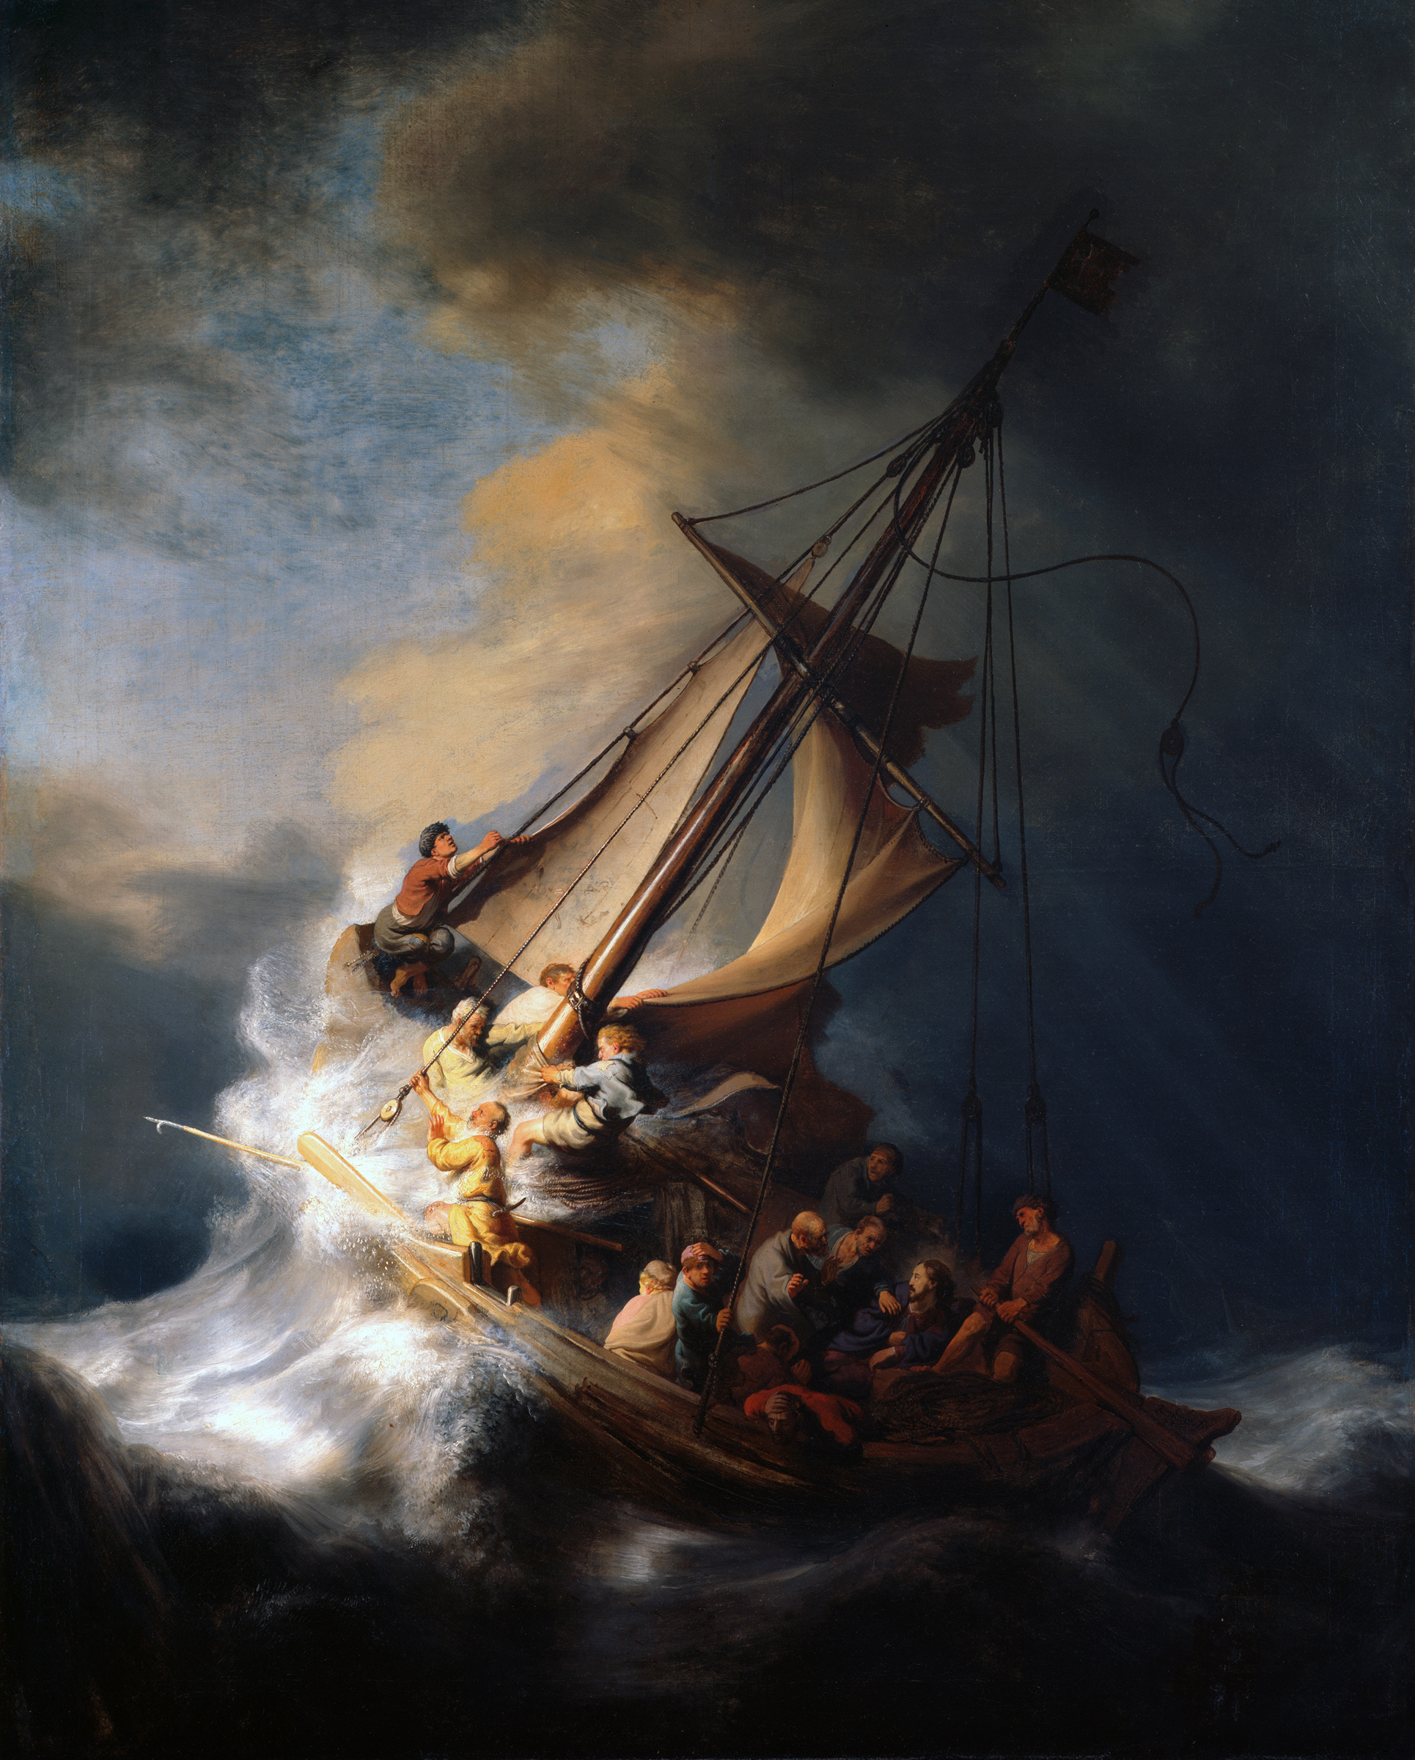
Project overview
Notes:
About the moral fabric of a society– not merely in terms of how we ask questions like “is it a person”, but how we make our deliberative institutions, and who we trust to know best—
-- not unlike H5N1 case– complex, scientifically uncertain area, prediction about the future that may or may not come to pass, reliance on experts to get the job done, but with uncertain consequences for others (moral, social, cultural, biological); the question of who is responsible for asking and answering these questions– scientists?, governments? Individuals? (which individuals)?

Slide 22
Robust governance requires:
Assessing institutions, not just individual experiments and technologies.
Looking back as well as forward to see patterns, routinized practices, frequently unasked questions.
Notes:
We are swept along with these changes only if we choose to go with the flow. Rudderless.

Slide 23
Robust governance requires:
building institutional capacity for inclusive participation, multiple languages, critical reflection, learning, and dissent.
(e.g. by inviting in outsiders to see what insiders cannot)
Notes:
We are swept along with these changes only if we choose to go with the flow. Rudderless.

Slide 24
Ethical responsibility requires asking hard questions together, and in ways that inform how science moves forward, rather than merely reacting to where it has gone. A commitment to ethics must be a commitment to infrastructures of participation and deliberation.
Notes:
We are swept along with these changes only if we choose to go with the flow. Rudderless.

Slide 25

Project overview
Notes:
About the moral fabric of a society– not merely in terms of how we ask questions like “is it a person”, but how we make our deliberative institutions, and who we trust to know best—
-- not unlike H5N1 case– complex, scientifically uncertain area, prediction about the future that may or may not come to pass, reliance on experts to get the job done, but with uncertain consequences for others (moral, social, cultural, biological); the question of who is responsible for asking and answering these questions– scientists?, governments? Individuals? (which individuals)?

Slide 26
Project overview
Thanks!
Notes:
About the moral fabric of a society– not merely in terms of how we ask questions like “is it a person”, but how we make our deliberative institutions, and who we trust to know best—
-- not unlike H5N1 case– complex, scientifically uncertain area, prediction about the future that may or may not come to pass, reliance on experts to get the job done, but with uncertain consequences for others (moral, social, cultural, biological); the question of who is responsible for asking and answering these questions– scientists?, governments? Individuals? (which individuals)?

